Slide 1
Woodcut Series ‘pigs’
Doreen Wells

Slide 2
Introduction
Although I have limited experience of pigs, the encounters that I had in earlier years have left a deep and lasting impression upon me. As Helen Browning (with Tim Finney) says in her wonderful and informative book ‘Pig’ “They do look you in the eye, at the same time as dismantling your footwear. They are curious, inventive and independent.” These are qualities that I admire. Several years ago I was walking along the Stour Valley path in Suffolk and came across an open free range pig farm with families of pigs housed in modern moveable pig arks. It was such a happy scene and it was obvious that these pigs were healthy and happy; I must have stayed for an hour watching the young piglets enjoying life. I was convinced that pigs farmed for food consumption should always be allowed such conditions. We should never compromise our human health and the biological nature of the pigs that we keep for food production in our search for cheap food. These woodcuts attempt to make this point.

Slide 3
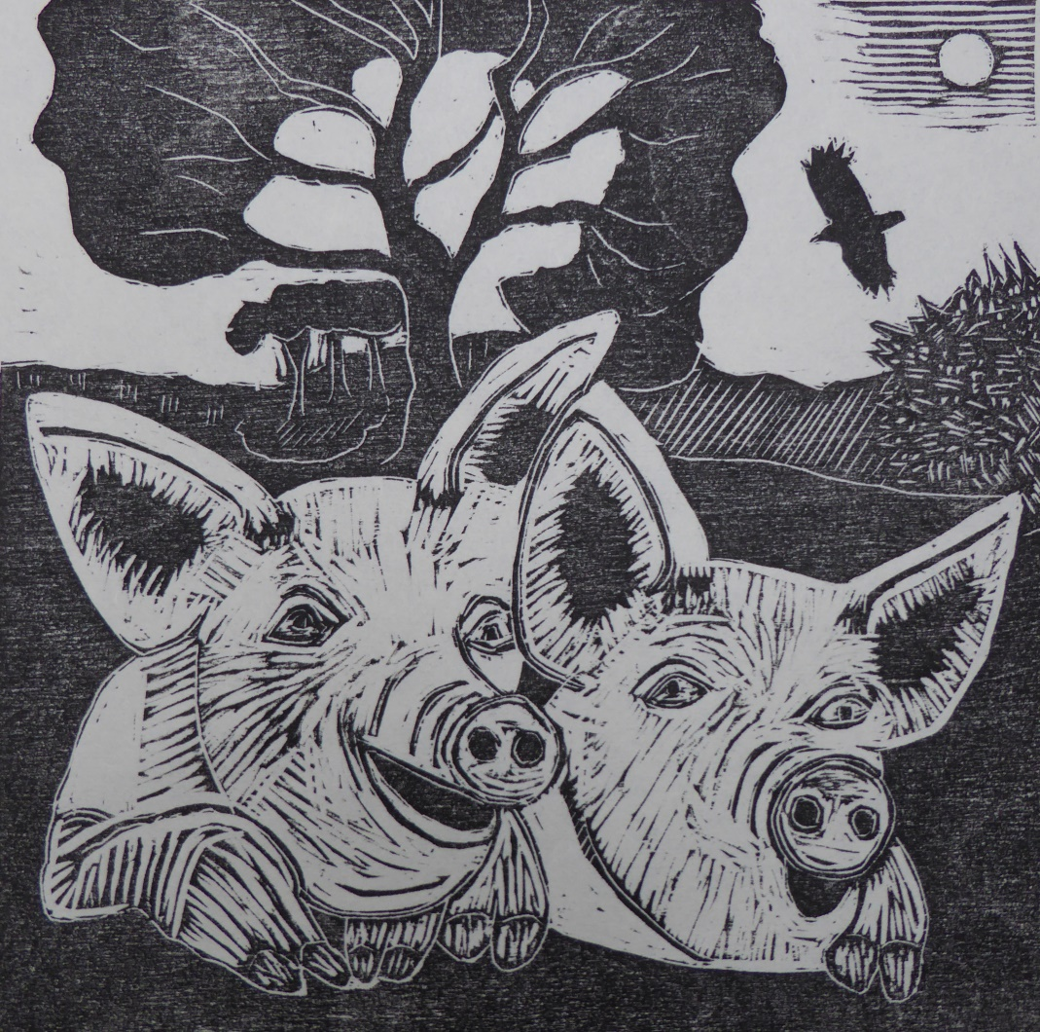
Two’s Company

Slide 4
Two’s Company
Two happy and healthy free range pigs – the ideal.
Why is it important to feed, house and breed healthy and happy pigs? The welfare of pigs should be our prime consideration for two very good reasons.
Good husbandry leads to important benefits for pigs and humans. Healthy pigs provide us with quality pork and bacon.
Organic and free range pig farms have methods of good husbandry which conform to guidelines of food quality as well as pig welfare.

Slide 5
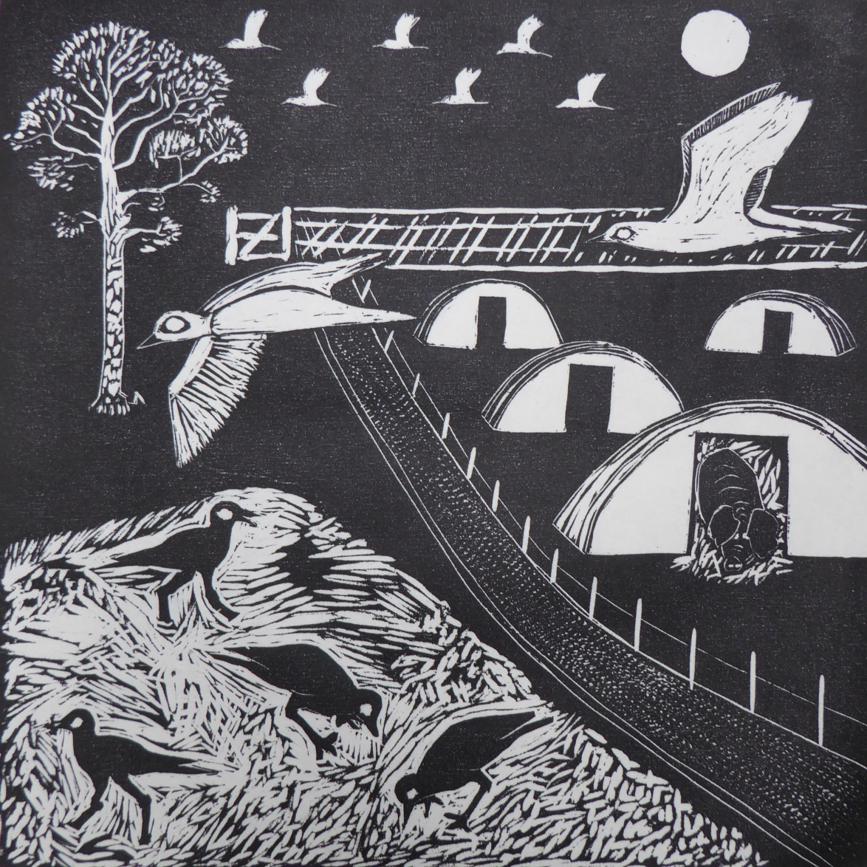
Night Visit

Slide 6
“Night Visit”
Stone Curlews flying to pig farms in the Brecks at night to feed on the dung heaps, which provide a rich source of insect food for the young. Pigs sleep contentedly in their nests (pig arks), while the birds fly in to access the food freely available.
Since the 1980s, when stone-curlews were on the brink of extinction in many areas, there has been a concerted effort by the RSPB and farmers to halt that decline and the UK population is now on the increase.
Stone Curlews are night feeders and fly off from the nest site to forage for food for up to 2 km, but until recently the importance of pig farms in that process was not recognised. Research has shown (see Research Poster) that pig fields and muck heaps are preferred over other habitats for foraging during the breeding season. Pig fields also provide safe roosting habitats for these birds in the autumn before their southbound migration. Juveniles and adult birds gather together in roosts of up to a hundred or more individuals.

Slide 7
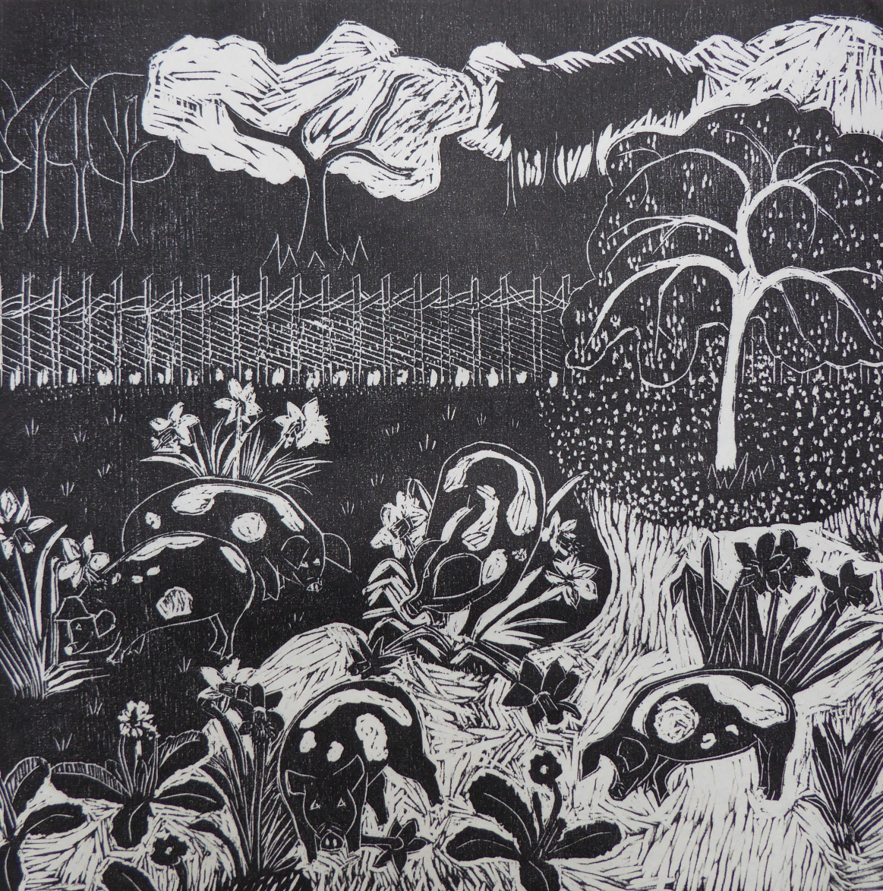
Playtime

Slide 8
Playtime
Young pigs in the spring, displaying their curiosity and fun loving nature.
A pig is a lovable rogue – a clean, intelligent, inquisitive and ingenious animal. They can also be incredibly comical, particularly when they are young.
They love to play, get up to all sorts of mischief and positively seek attention.

Slide 9
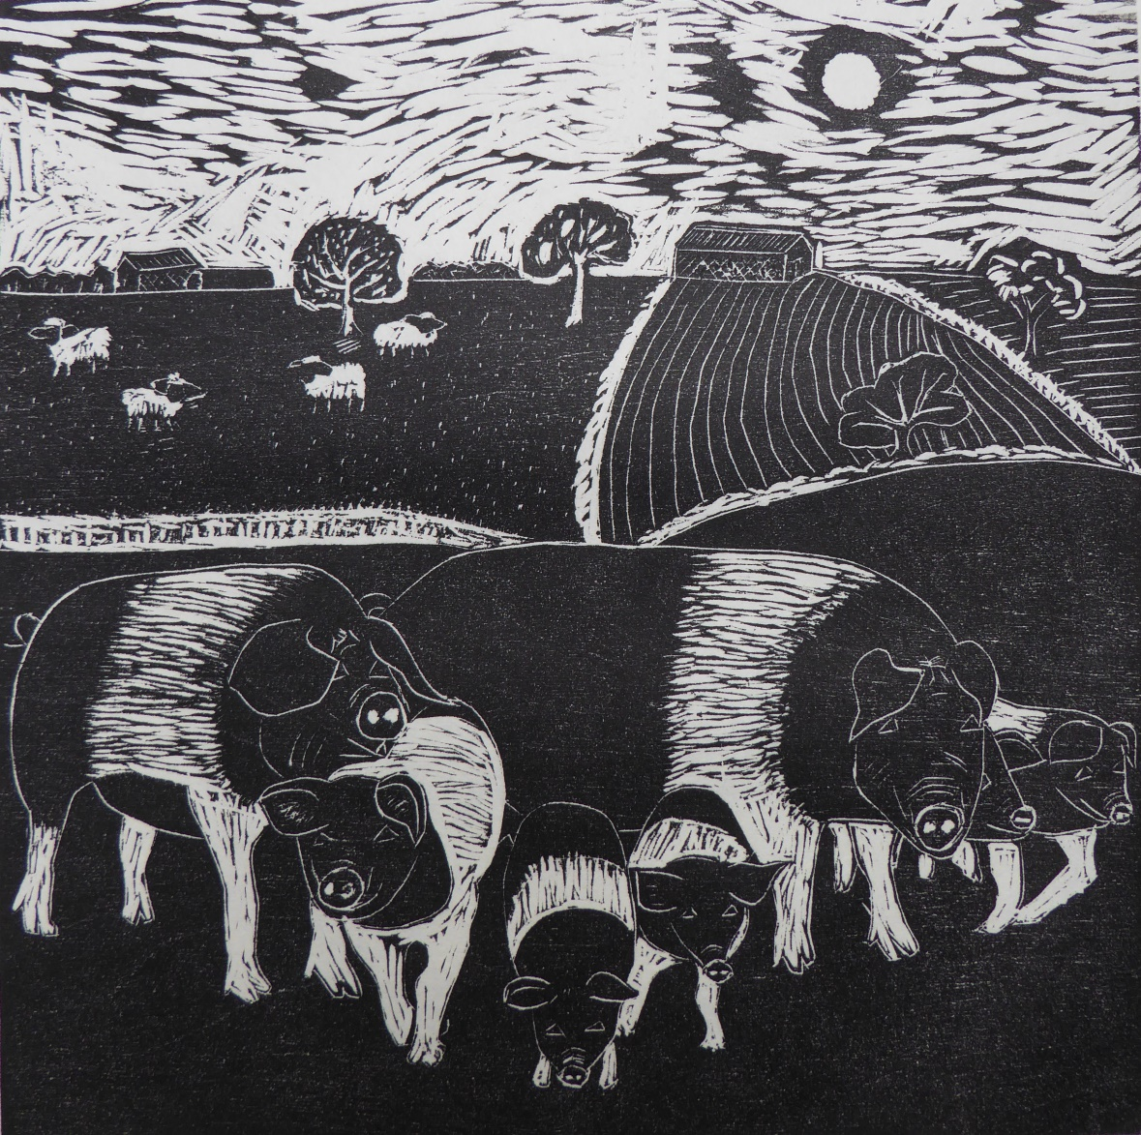
Pig Families

Slide 10
Pig Families
Pigs are social animals and often form part of mixed organic farms.
Pigs are gregarious animals and spend most of their lives in groups, usually of two to six animals but more if young are present. They like to interact with humans as well as other pigs and really enjoy being scratched.
They are clean, intelligent and social animals by nature.

Slide 11
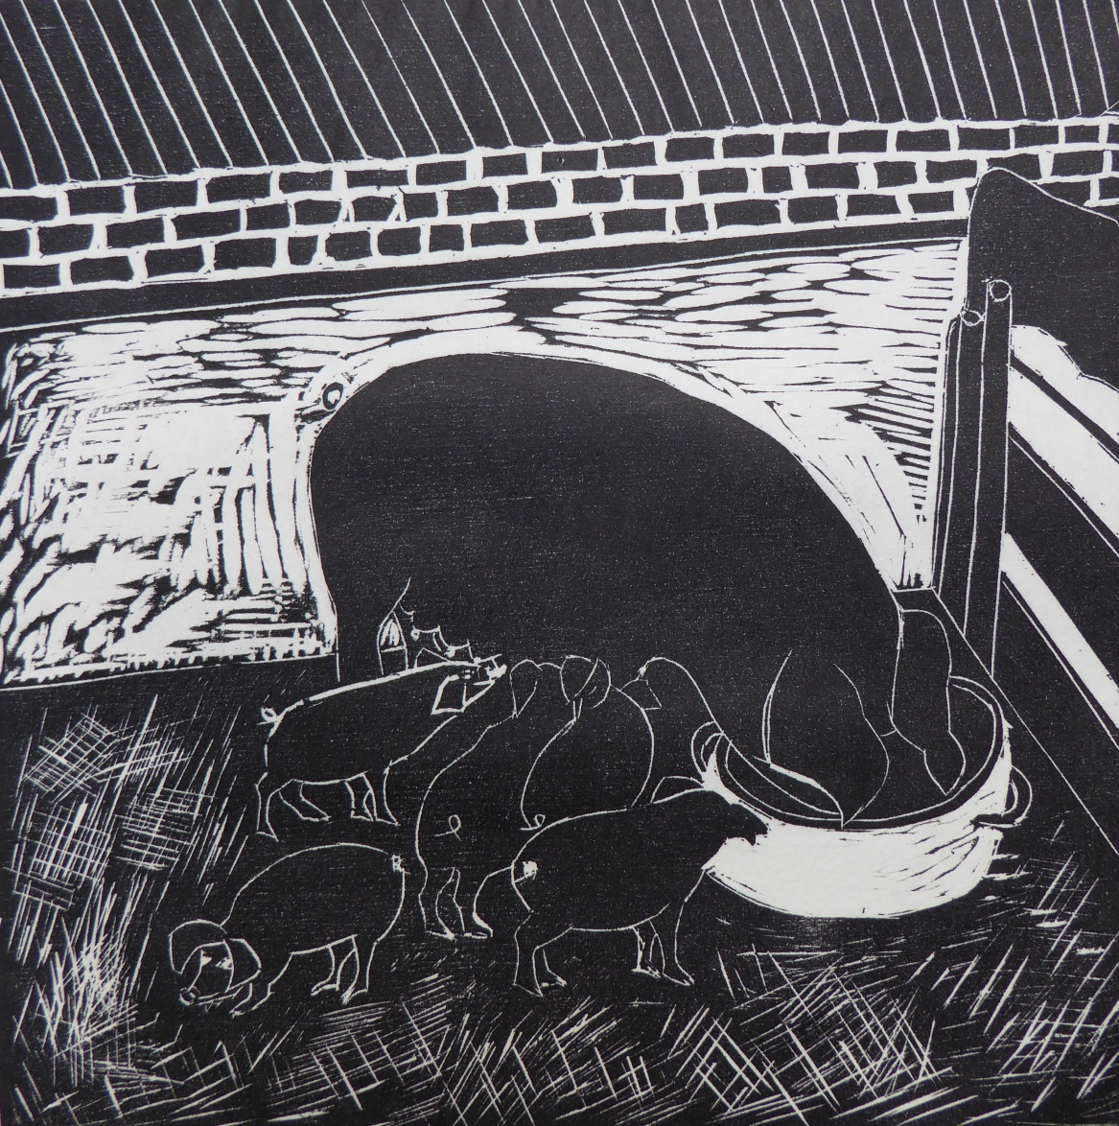
Farrowing

Slide 12
Farrowing
Sow feeding with young piglets in sty.
The traditional sty, where a single pig would have been housed in the past, has mostly been superseded, but it can be successfully used as accommodation for a farrowing sow, provided it is warm, comfortable and plenty of straw is available to make a nest.

Slide 13
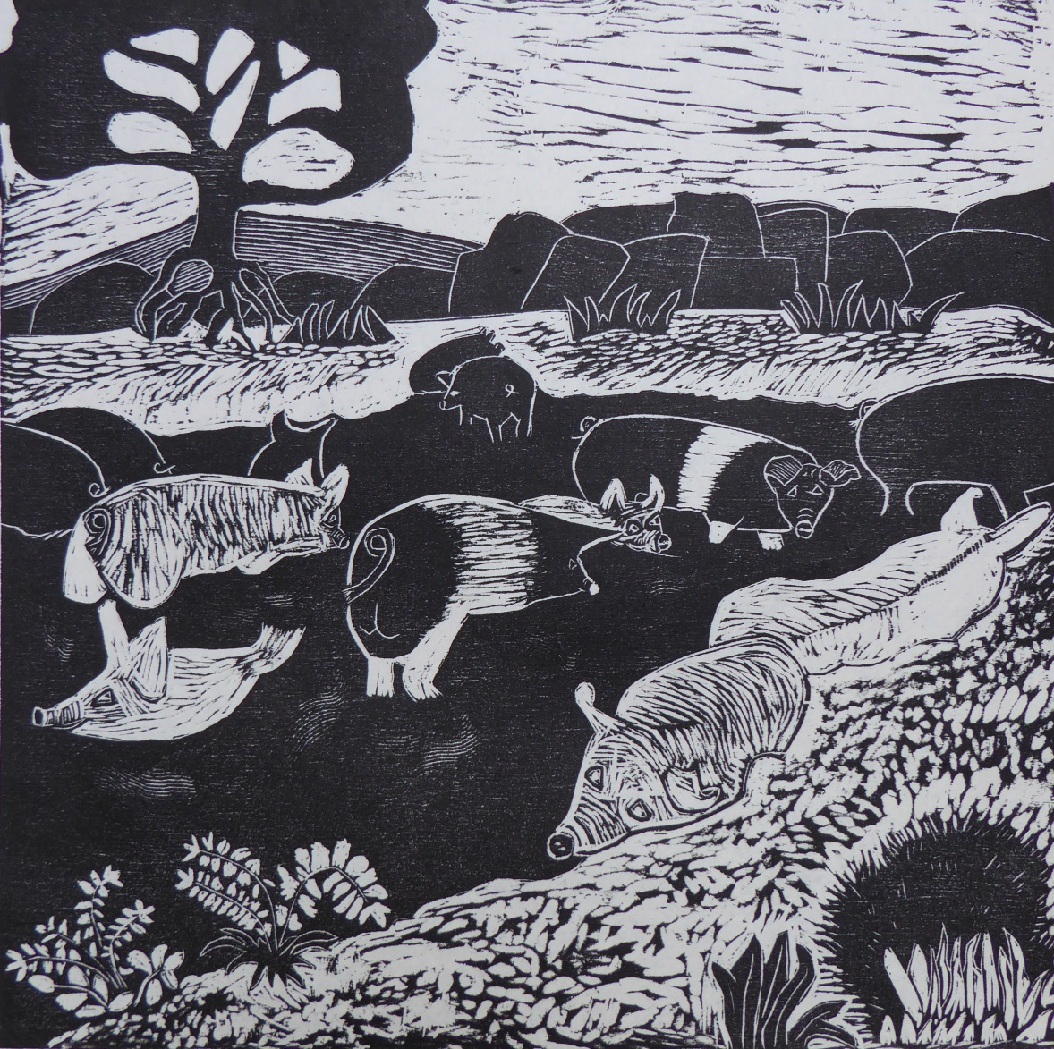
Mud, Mud, Glorious Mud

Slide 14
Mud, Mud, Glorious Mud
Pigs wallowing in water and mud in hot weather.
Pigs have limited temperature regulatory abilities and need to keep cool by wallowing in water and mud to prevent sunstroke, particularly light skinned pigs.
Shade provided by trees is also advantageous.

Slide 15
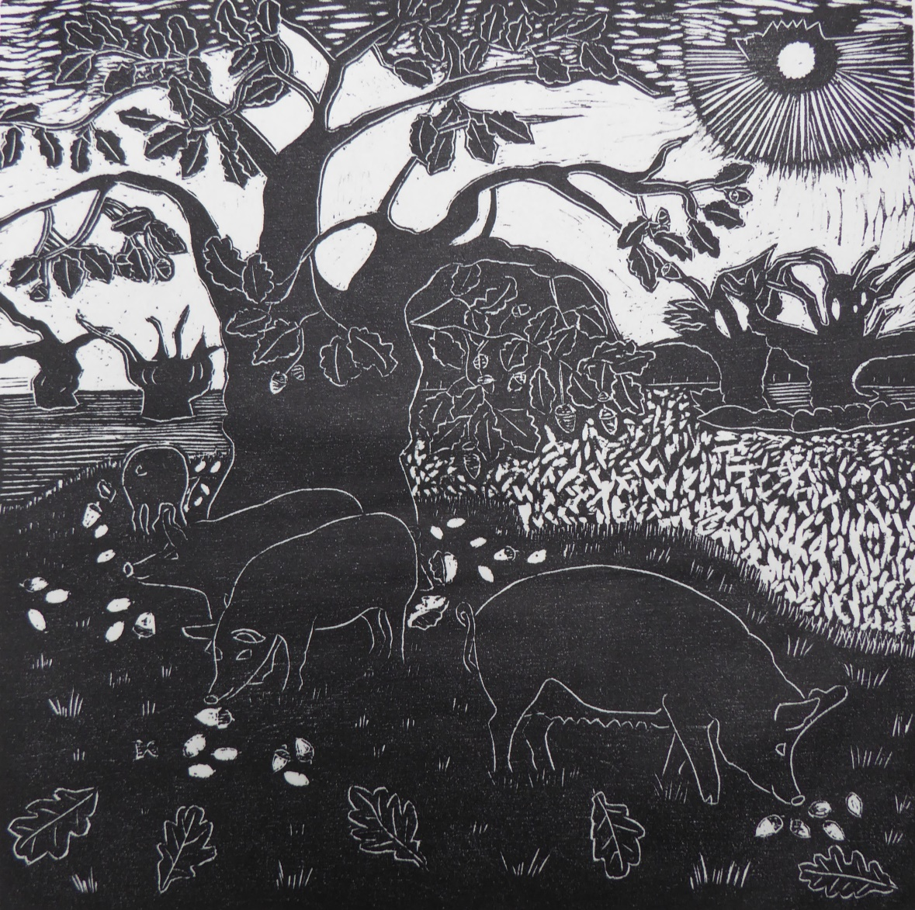
Pigs in Oak Woodland in Autumn

Slide 16
Pigs in Oak Woodland in Autumn
Pigs rooting for acorn harvest. This has been a common practice in the past for pigs to be turned out into wood pasture during the acorn harvest to root for acorns to supplement their diet, something which they appear to thoroughly enjoy. Today this is still practiced in the New Forest by Commoners during Pannage, which is a period of at least 60 days in the Autumn. This brings benefits also to the New Forest ponies, as pigs eat green acorns and beech nuts, which are poisonous if the ponies eat them.
Traditionally, there was always a link between pigs and soil management, but industrial processes destroy this link. However, it is possible to restore this link and in some parts of the UK pigs are being used again as a tool for managing the land. It is natural for pigs to root and forage with their snout. They have a strong sense of smell and their noses are equipped in many breeds to act like mini diggers!
Pigs can be of benefit to woodland as they clear undergrowth and allow regeneration. That is better for nature and biodiversity. Pigs will also clear an area and fertilise it so that it can be ready for ploughing and planting. Moreover, their ability to enrich the soil is greater than other livestock. Pig manure has a very high nutrient content and is rich in potash and phosphorus. When we so desperately need to reduce our reliance on chemical fertilisers, this is worthy of consideration.

Slide 17
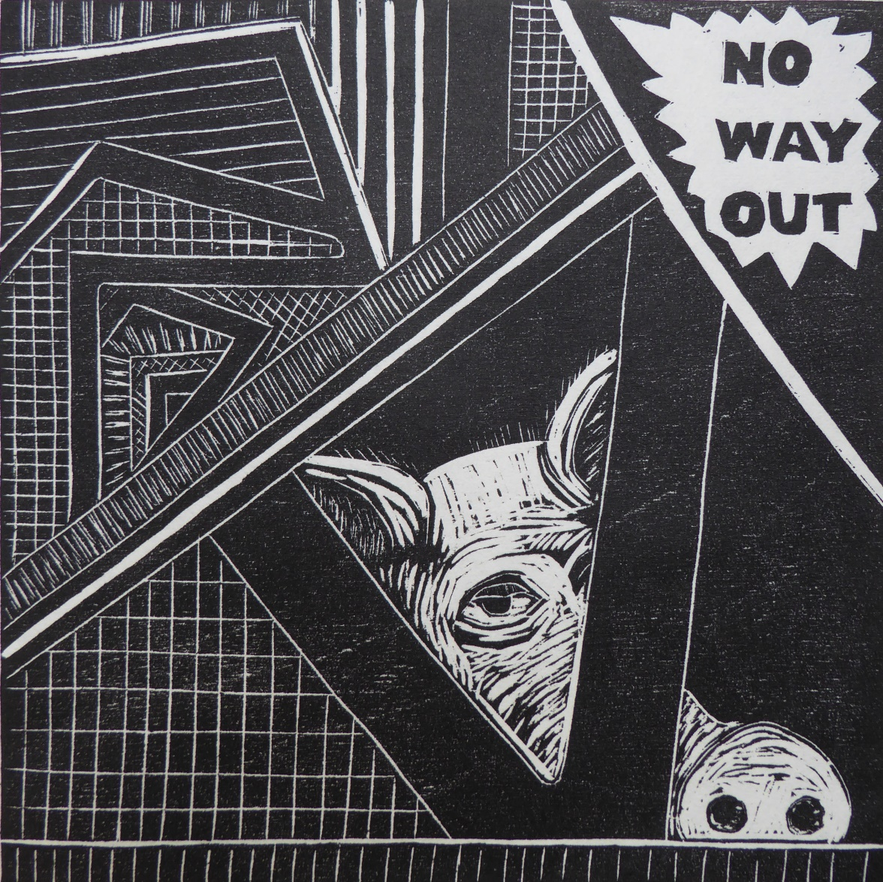
No Way Out

Slide 18
No Way Out
Sow confined in inhumane conditions in intensive industrial pig unit.
Legislation in the UK and the EU prevents the worst excesses of industrial processes that take place in other countries. In some countries the biological needs of pigs are not taken into consideration at all, in the ever increasing demand for increased productivity and cheap meat. Pigs are imprisoned by humans without room for exercise, mental stimulation or social interaction. Permanently housed indoors with insufficient room to move, pregnant sows are trapped in individual stalls called gestation crates, and then moved to farrowing crates with no direct social contact with their piglets, which suckle through bars from an adjacent pen.
Intensive farming methods bring their own problems in terms of the spread of disease. To overcome this and to encourage growth, drug programs are pre-emptively administered with antibiotics, vitamins, hormones and other supplements. When pigs are confined in individual stalls the automatic feeding system allows medication through feed. This has led to the overuse of antibiotics in animal welfare and is a direct threat to human health.
Let pigs become part of our search for low carbon farming structures now and in the future and we will not only have happy healthy pigs, but happy healthy humans too.

Slide 19
Artist Statement – Doreen Wells
Aims and objectives
Food and farming has a huge role to play in helping us to adapt to Climate Change. Through my series of eight woodcut prints I wanted to cast light on pig farming today and to identify the benefits that pigs can bring in helping us to convert to low carbon farming structures.
Influences
The artistic influences on my work are many and varied, but most important among these is the work of the great master Japanese printmaker Shiko Munakata, whose free style of cutting the blocks impressed me so much at Art College. Others include the woodcut prints of the German Expressionists as well as the American and European Graphic Novels (storytelling without words).
The farming influences which bear directly on my artwork are ‘Pig: tales from an organic farm’ by Helen Browning with Tim Finney (a wonderful and inspiring book) and talks given by Peter Melchett at the Greenhouse and 'Wild Harvest', a Natural World Programme filmed in 2005, on Peter Melchett's organic farm in Kings Lynn.

